Slide 1
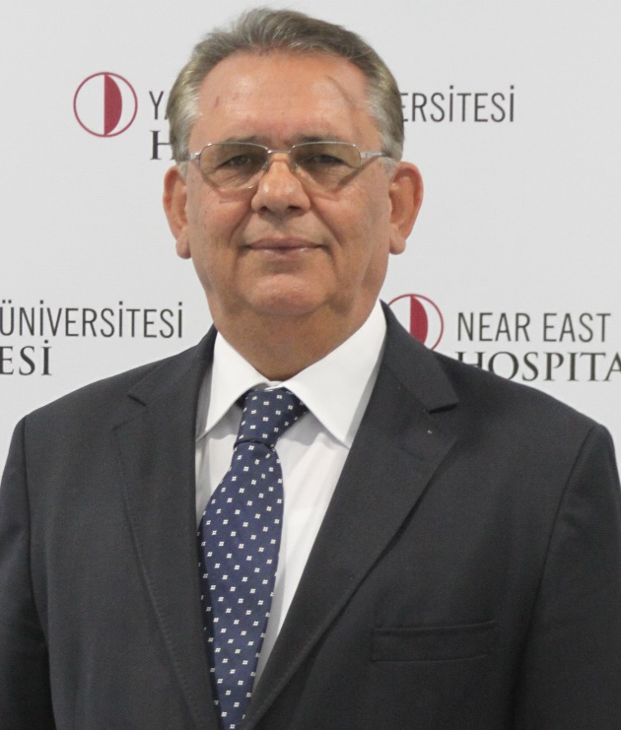
Case of the Month Prize Question
Ferhat Erişir, MD – Department of Otorhinolaryngology
Ali Temelci, DDS – Department of Oral and Maxillofacial Surgery
Gürkan Ünsal, DDS – Department of Dentomaxillofacial Radiology

Slide 2
Case Presentation
47-year-old female patient
No systemic disease was present
No history of surgery was present
Medication naive
Intraoral examination did not reveal any pathology at the surrounding tissues.
An expansive lesion was present at the left maxillary sinus

Slide 3
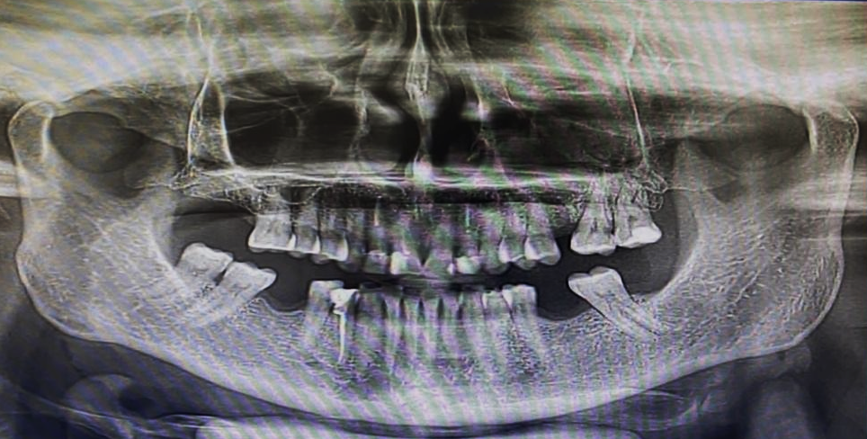
OPG

Slide 4
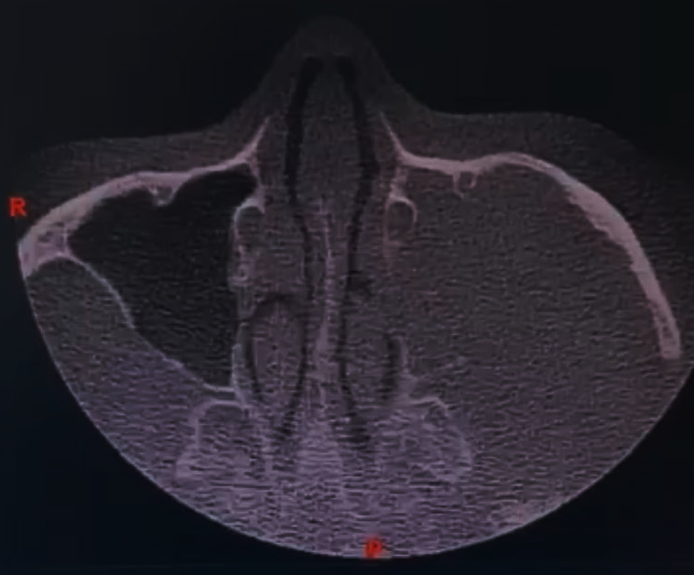
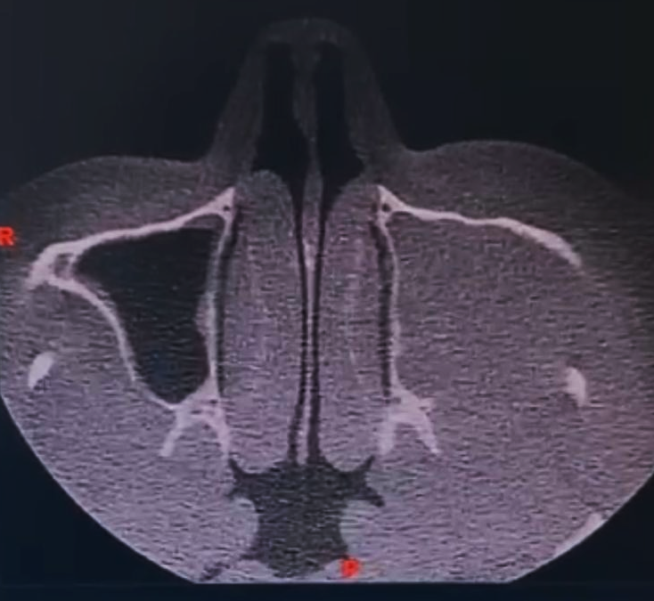
CBCT

Slide 5
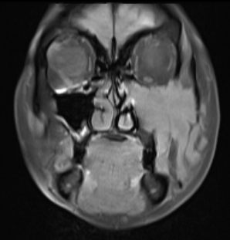
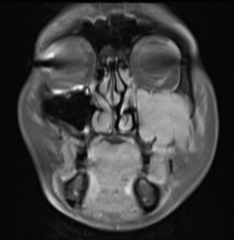
T1W-TSE-FATSAT

Slide 6
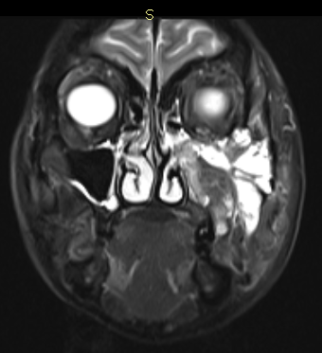
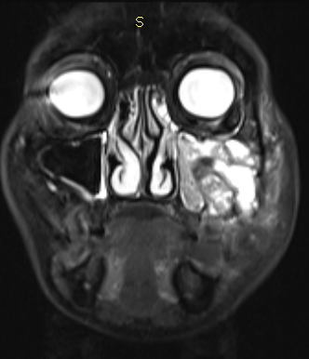
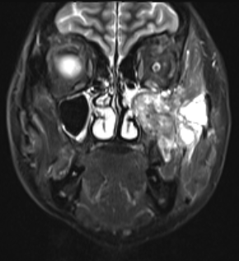
T2W-TSE-STIR

Slide 7
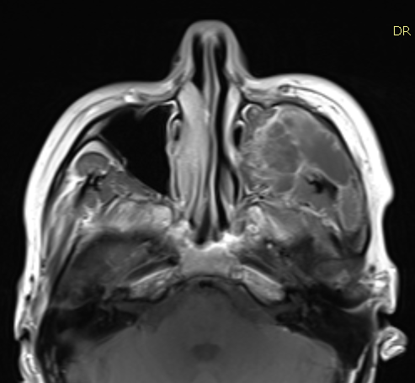
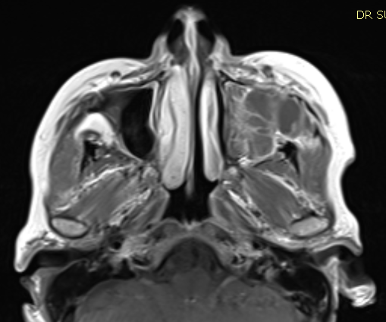
T1W-TSE +C

Slide 8
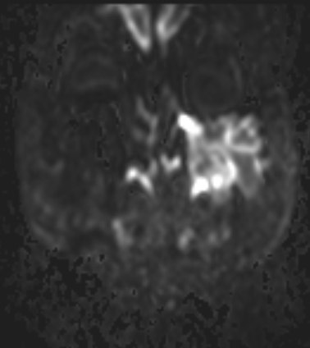
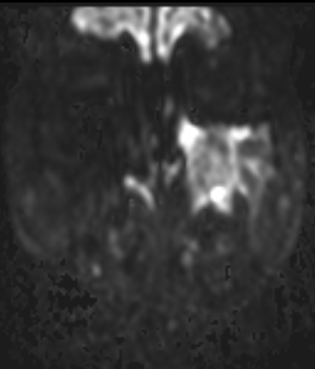
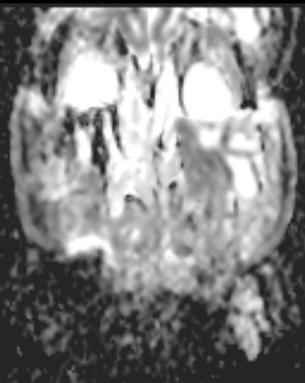
DWI / b=800
ADC

